Slide 1
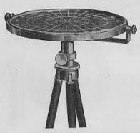
The WInd VElocity Radar Nephoscope (WIVERN): a candidate mission for the ESA Earth Explorer 11
Battaglia, A. Illingworth, F. Tridon, A. Rizik, P. Martire, F. Scarsi, M.Pourshamsi and ESA MAG team
Notes:
1

Slide 2
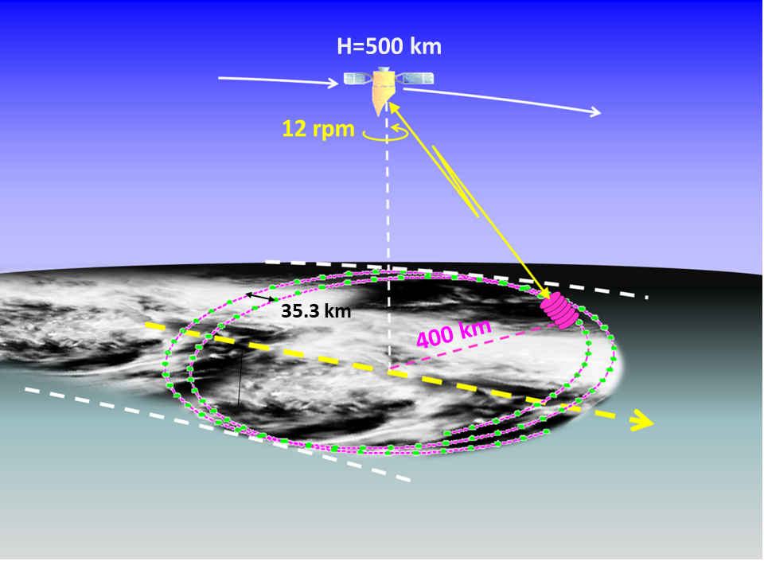
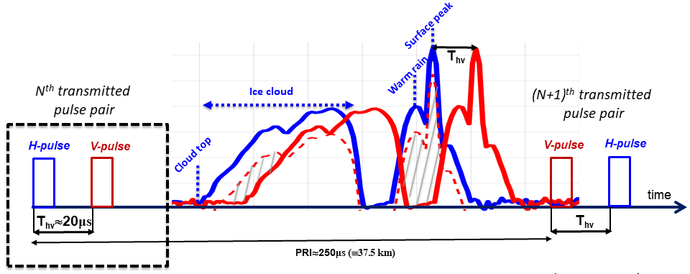
WIVERN: new observation concept
WIVERN will have a single instrument: a conically scanning dual-polarisation 94GHz Doppler (W-band) radar with a 3m diameter antenna sampling an 800km wide swath with 640m vertical resolution.
Doppler velocity is derived from the phase shift of the returns from successive pulses with polarisation diversity. A folding velocity of 40m/s is achieved by sending H&V pulses separated by 20μs, close enough to beat the fast decorrelation time of atmospheric targets while keeping unambiguous ranges long enough to sample the troposphere.
Extensive tests with ground based/airborne 94GHz radars have confirmed that accurate velocities are obtained using H-V pulse pairs.
WIVERN will have a radiometric mode, to measure the upwelling 94GHz radiation with global coverage and unprecedented high spatial resolution (beam matched with the radar signal).
Wolde et al., AMT 2018
Illingworth et al., BAMS, 2018.
Battaglia et al., IEEE TGRS, 2017
Battaglia et al., AMT, 2018, 2022, 2023
www.wivern.polito.it

Slide 3
WIVERN: Science justification and objectives
Continuous improvement in Numerical Weather Prediction has been a quiet revolution. WIVERN with its Doppler radar will provide novel data for assimilation: the first global observations of vertical profiles of in-cloud winds, 94 GHz radar reflectivity and brightness temperatures at the km scale over an 800km swath visiting each 20km by 20km area over the Earth about once a day. When combined with the Doppler lidar winds of Aeolus-2 (launch ~2030) NWP performance should improve further.
Global temperatures have already risen by 1◦C. To understand the feedbacks in the energy and water cycle, associated changes in global winds, cloud cover and precipitation must be monitored. WIVERN will ensure continuation of CloudSat&EarthCARE global data sets from the year 2030 and establish the first wind climatological record.
Much rainfall results from convection which is currently NOT resolved in NWP and climate models. By 2030 they will explicitly model convection. WIVERN will observe the statistical properties of convective motions at km-scale such as the spatial distribution and vertical extent of up and down draft and the link to clouds and the production of heavy rainfall which, will aid evaluation and improvement of these new models (EXPLORATORY).

Slide 4
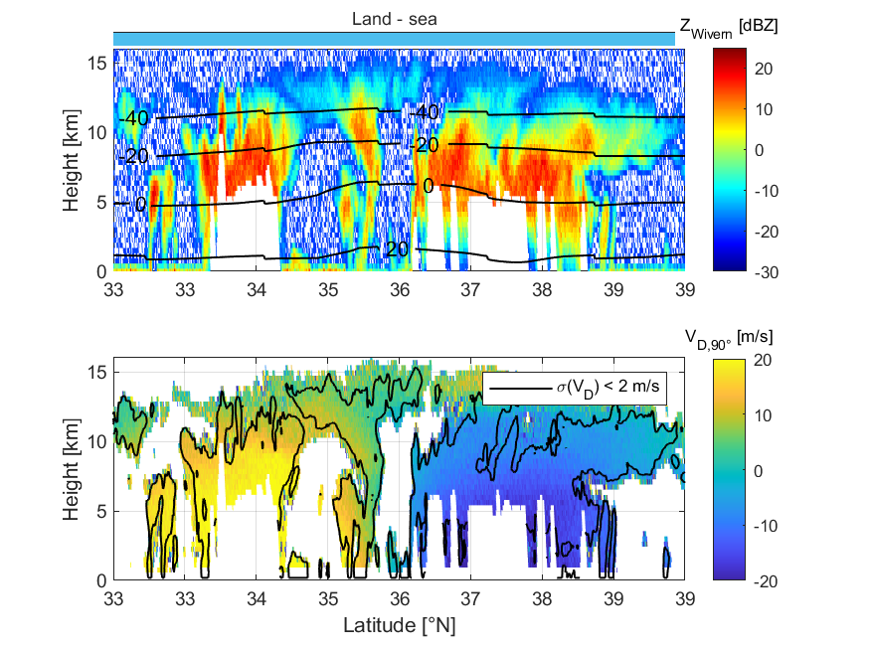
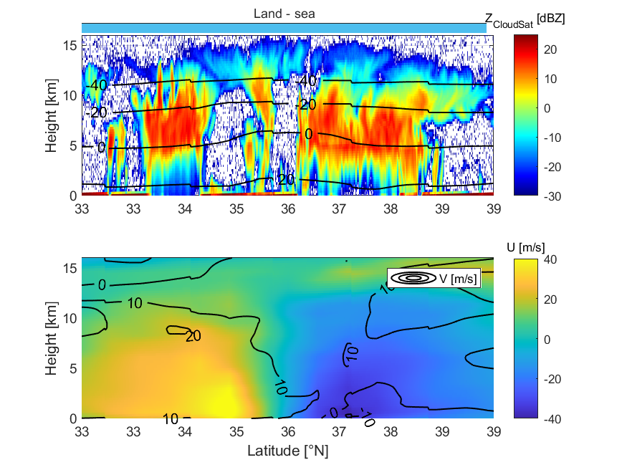
WIVERN end-to-end simulator
A simulator is under development to understand instrument performance (Battaglia et al., AMT 2018,2022).
Example of reconstructed Wivern observations based on CloudSat measurements in hurricane Bill (22/8/2009) accounting for the slant sampling acquisition (increased attenuation, reduced clutter).
WIVERN simulated
CLOUDSAT
WIVERN reflectivity
reconstructed from CloudSat reflectivity. White vertical stripes: total attenuation of the radar signal
ECMWF
Winds retrieved by the simulator using ECMWF model winds.
Notes:
A WIVERN E2E Simulator has been developed that uses winds from the ECWMF analysis and CloudSat reflectivities to simulate WIVERN observables. Below an example of a CloudSat overpass over typhoon Mitag.
How many winds in cyclones?
In 2007 CloudSat observed 1250 overpasses of Tropical Cyclones (TCs) with, on average, 5600 wind precise to 2 m/s per overpass predicted by the simulator.
For each TC overpass, WIVERN, sampling an 800 km swath by scanning at 500 km/s, will observe 35 times more profiles than CloudSat samples at vertical incidence.
Over a typical year, with 1250 overpasses over TCs, WIVERN should measure 245 million winds in TCs with a precision of 2 m/s.

Slide 5
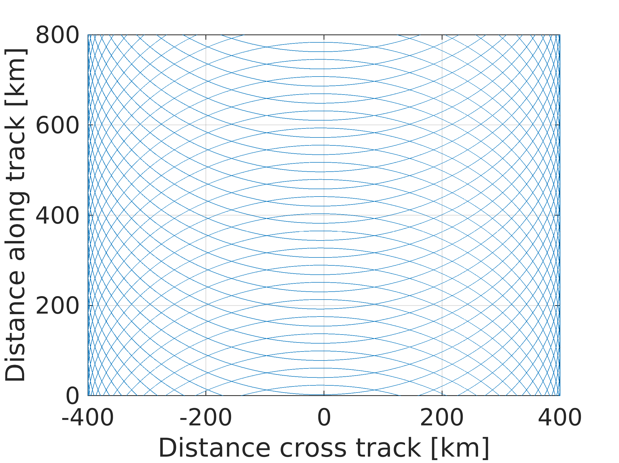
WIVERN mission products
But tricky sampling
CLOUD and PRECIPITATION PRODUCT based on the heritage of CloudSat and EarthCARE cloud profiling radars, but with 30-40 times better sampling
+T_{B}s
WIND FLAGSHIP PRODUCT (after C/S flagging and few corrections for mispointing, non uniform beam filling and vertical hydrometeor terminal velocity), directly used in data assimilation
Notes:
A WIVERN E2E Simulator has been developed that uses winds from the ECWMF analysis and CloudSat reflectivities to simulate WIVERN observables. Below an example of a CloudSat overpass over typhoon Mitag.
How many winds in cyclones?
In 2007 CloudSat observed 1250 overpasses of Tropical Cyclones (TCs) with, on average, 5600 wind precise to 2 m/s per overpass predicted by the simulator.
For each TC overpass, WIVERN, sampling an 800 km swath by scanning at 500 km/s, will observe 35 times more profiles than CloudSat samples at vertical incidence.
Over a typical year, with 1250 overpasses over TCs, WIVERN should measure 245 million winds in TCs with a precision of 2 m/s.

Slide 6
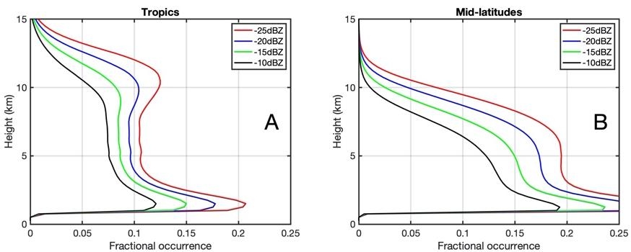
Expected number of daily winds
When applied to the CloudSat database, analysis indicates that, with a single-pulse sensitivity of –15 dBZ (green curve), 10% of the time there is a cloud with Z exceeding -15 dBZ at 20 km horizontal resolution between 2 and 10 km, i.e. a wind measurement with less than 2 m/s error each profile ➔ 25 wind measurements each second.
WIVERN will provide about 2 millions accurate winds daily at 20 km horizontal and 650 m vertical resolutions.
Touchstones
Atmospheric Motion Vectors: ~7M/day, 300k/day DA
(error ~4m/s)
Aircrafts: 1 M/day, 360K/day DA
(error 2.0m/s)
ADM Aeolus: 130,000 Rayleigh (89 km) & 50,000 Mie- cloudy (12 km) in DA
Notes:
A WIVERN E2E Simulator has been developed that uses winds from the ECWMF analysis and CloudSat reflectivities to simulate WIVERN observables. Below an example of a CloudSat overpass over typhoon Mitag.
How many winds in cyclones?
In 2007 CloudSat observed 1250 overpasses of Tropical Cyclones (TCs) with, on average, 5600 wind precise to 2 m/s per overpass predicted by the simulator.
For each TC overpass, WIVERN, sampling an 800 km swath by scanning at 500 km/s, will observe 35 times more profiles than CloudSat samples at vertical incidence.
Over a typical year, with 1250 overpasses over TCs, WIVERN should measure 245 million winds in TCs with a precision of 2 m/s.

Slide 7
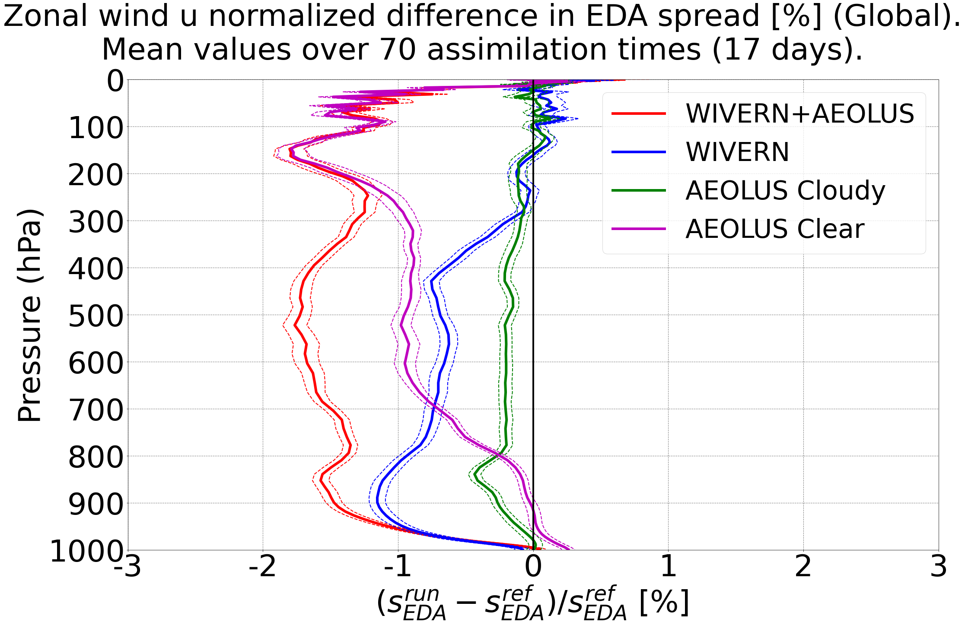
WIVERN impact on data assimilation
WIVERN observations of in–cloud winds when combined with the winds from the clear air and thin clouds from the Doppler lidar on the recently approved Aeolus follow-on mission will produce a significant improvement in NWP forecast accuracy.
Impact measured by a reduction of the operational Ensemble Data Assimilation spread for the ARPEGE global NWP model at analysis time and other forecast ranges (K.Lean, 2022).
WIVERN has a significant positive impact on the reduction in EDA spread, especially in the lower troposphere (below 300 hPa).
Courtesy: Mary Borderies, Meteo France

Slide 8
Conclusions
WIVERN is an ESA EE11 candidate mission, currently in Phase 0 (on-going industrial and science activities, field campaigns, calibration strategy definition).
It hinges upon a single cutting-edge radar instrument: first-ever conically scanning W-band radar with Doppler capabilities.
Flagship product: in-cloud vertical profiles of winds over a large swath➔ plenty of winds are expected (>2 million line of sight wind measurements at 20 km resolution per day) with expected great impact in data assimilation (complement Aeolus in cloudy mid and low troposphere region)
Cloud and precipitation product: as done in CloudSat/EarthCARE but with 30-40 times better sampling
Ideal observing system for understanding clouds and their dynamics!

Slide 9
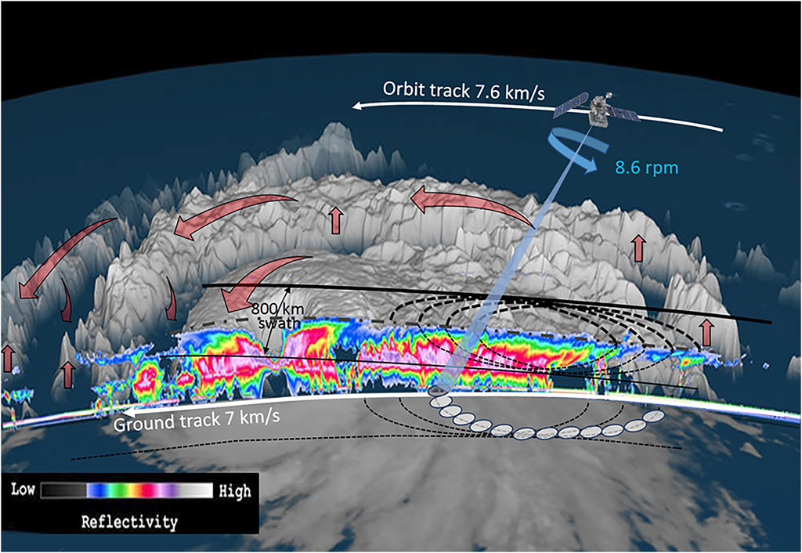
Thanks for the attention
12 rpm
www.wivern.polito.it
Contact point: alessandro_battaglia@polito.it

