Slide 1
The potential of the W-band polarization diversity Doppler radar envisaged for the WIVERN mission for sampling tropical cyclones
F. Tridon, A. Battaglia and A. Illingworth
Notes:
1

Slide 2
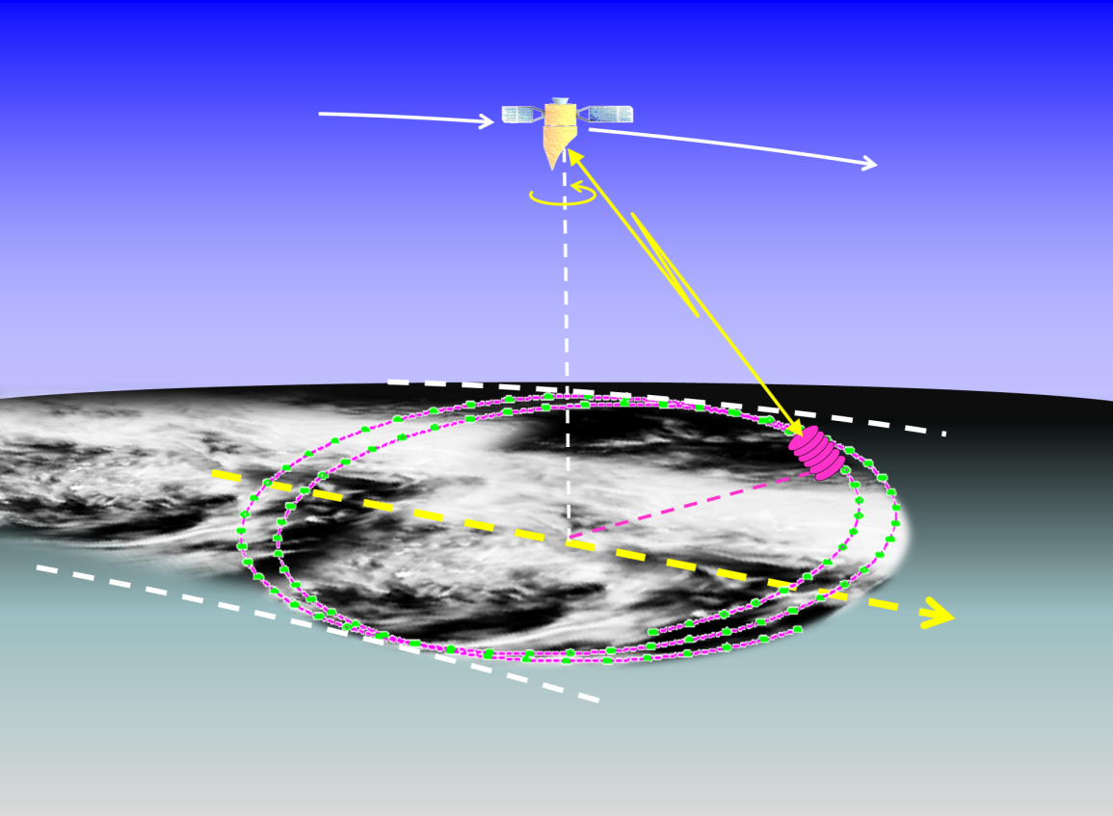
Wind Velocity Radar Nephoscope (WIVERN): ESA Earth Explorer 11 candidate
Currently one of the 4 candidates in Phase-0
W-band (94 GHz, transmitter similar to CloudSat)
Doppler (polarization diversity)
conically scanning at 41 degrees
big antenna (θ_{3dB}≈0.07º)
Wolde et al., AMT 2018
Battaglia et al, AMT, 2018
Illingworth et al., BAMS, 2018.
Battaglia et al, IEEE TGRS, 2017
Battaglia et al, JTech, 2015
First mission to acquire line-of-sight wind profiles in clouds on a global scale.
Near-real-time observations with precision better than 2 m/s will improve NWP via monitoring of the vertical structure of winds and by capturing early stages of cyclogenesis.
www.wivern.polito.it
AS1.8 Wed, 26 Apr, 17:30–17:40
Wivern will complement in mid-troposphere cloudy areas observations from aircrafts, scatterometers, ADM-AEOLUS, and cloud motion winds from sequential geo images.

Slide 3
WIVERN and Tropical Cyclones
ONE OF WIVERN SCIENCE OBJECTIVES
To improve NWP analyses and re-analyses of the atmospheric state and
climate models by observing at a global scale high resolution detailed dynamic and microphysical structures of weather systems, including high-impact tropical cyclones and mid-latitude windstorms.
SCIENCE QUESTIONS
Can the 94 GHz WIVERN “see” inside tropical cyclones? How frequently is the 94 GHz signal fully attenuated?
In which part of the systems will WIVERN be able to provide Doppler profiles with good accuracy (e.g. <3 m/s)?

Slide 4
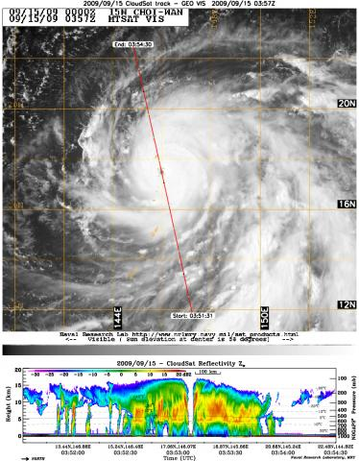
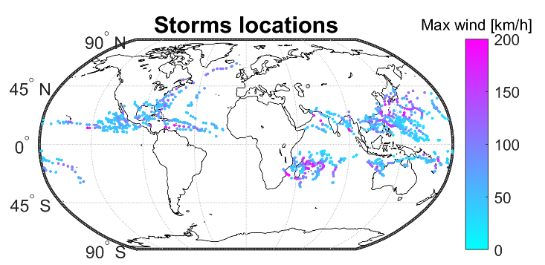
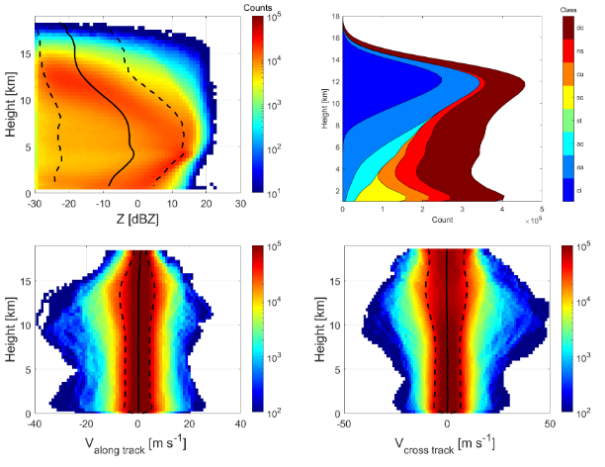
The Tropical Cyclone CloudSat dataset
CloudSat data: 2007 overpasses of 89 TC within 1000 km of Tropical Cyclone centres
1000 km
Contour frequency altitude displays from CloudSat products
Reflectivity
Cloud type
Up to 17 km
33% convective
Up to 50 m/s horizontal winds
Winds

Slide 5
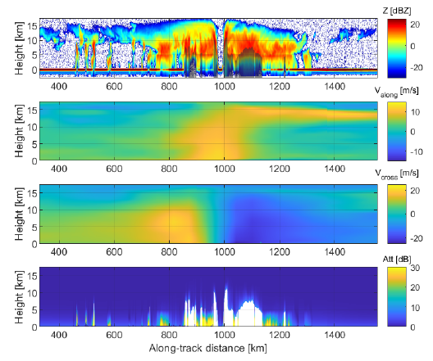
Example of CloudSat observations: typhoon Choi-wan (15 Sep 2009)
Tridon et al, 2023, under submission
Reflectivity curtain from 2B-GEOPROF
ECMWF cross-track and along track winds
Attenuation estimate from 2C-RAIN-PROFILE
(+ iterative correction up to 6 dB where surface is not visible)

Slide 6
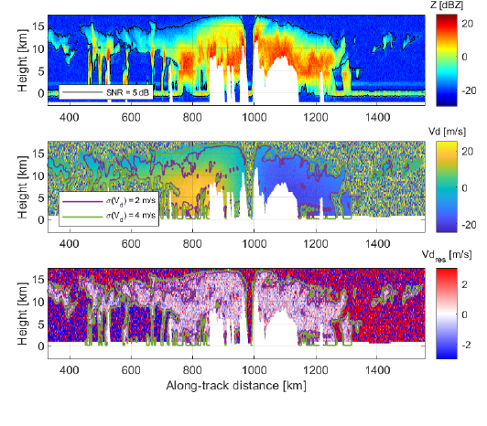
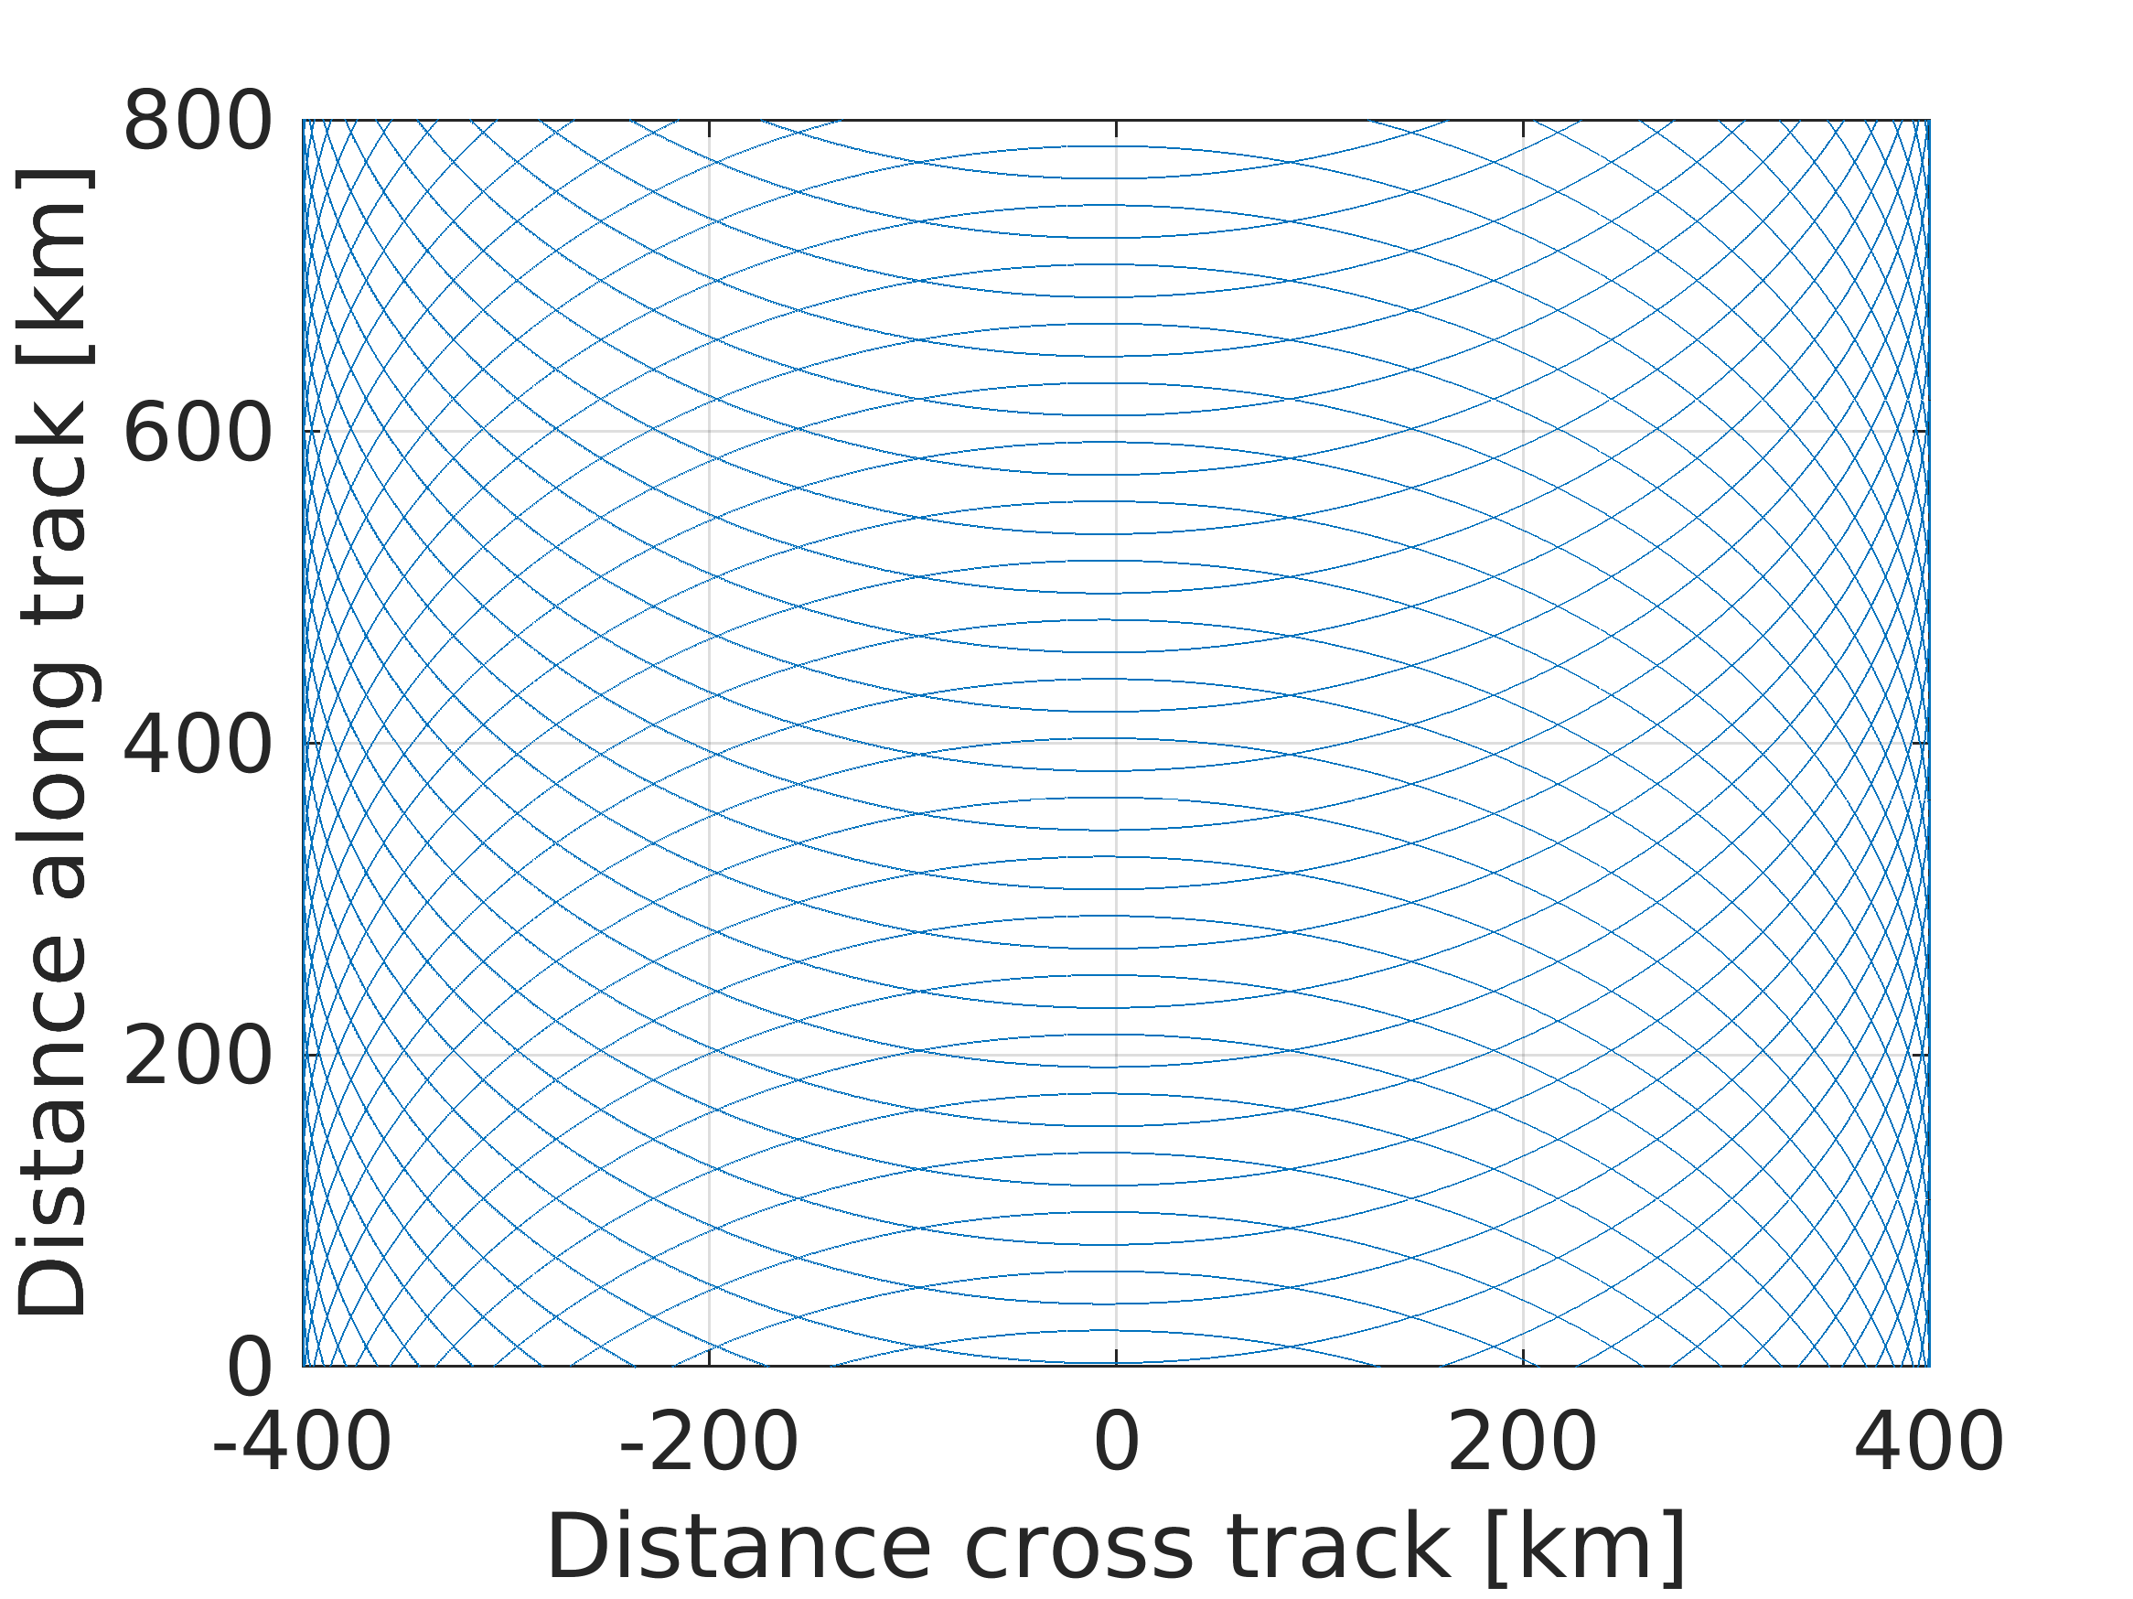
WIVERN simulation: typhoon Choi-wan (15 Sep 2009)
SIDE VIEW
Method based on Battaglia et al.,
AMT 2022
WIVERN reflectivity curtain with no data where attenuation is unknown
Scanning pattern
Line of sight winds
Doppler velocity residuals after correcting for non uniform beam filling and wind shear biases

Slide 7
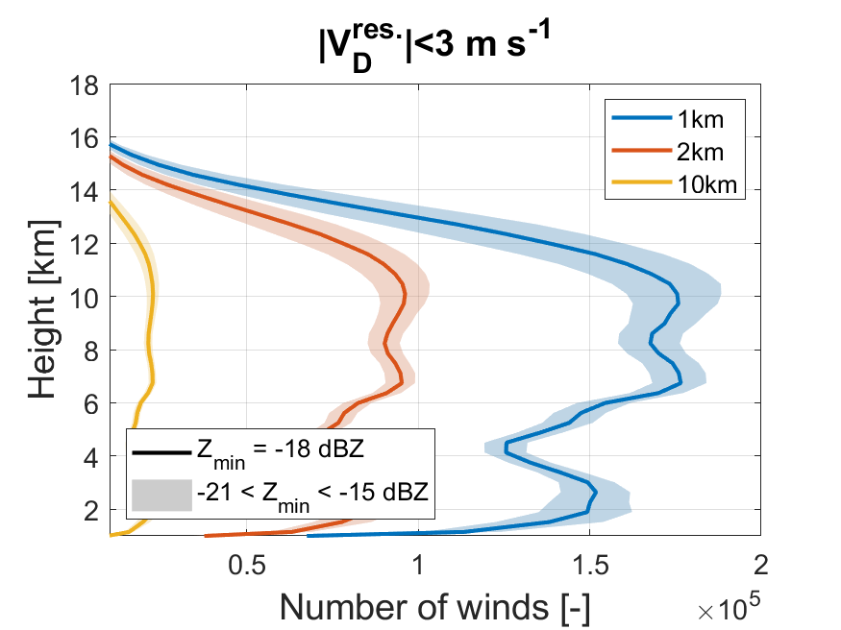
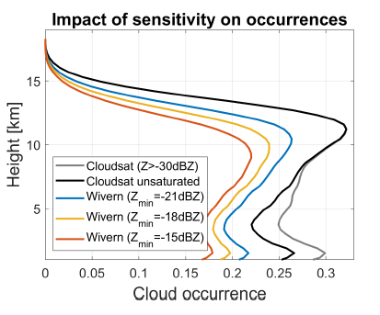
Statistical results
Indicative of radar
sensitivity
Below 11 km, WIVERN will measure winds with an accuracy better than 3 m/s (better with increasing sensitivity and longer integration length) for at least 35% of the CloudSat clouds The number of wind observations will peak between 7 and 11 km height
WIVERN will detect on average 78% of the clouds (better with increasing sensitivity)
Only 5% of clouds detection is lost due to too strongly attenuated profiles

Slide 8
How many precise winds measurements?
Wivern will produce accurate winds (clouds) on roughly (35) 70% of the pixels seen by CloudSat
Wivern will map cyclones with a sampling 66 times better than CloudSat
1000 km
for Tropical Cyclone overpasses
WIVERN WIND OBS≈ 23 X CLOUDSAT OBSERVATIONS
WIVERN CLOUD OBS≈ 46 X CLOUDSAT OBSERVATIONS
Over a year CloudSat produces 1.8 million profiles within 1000 km at 2 km resolution➔ WIVERN will measure >40 million wind profiles in TC.
If we assume an average of 20 layers of 500 m with a 20% cloud cover this implies that Wivern will measures 160 million accurate winds in TC

Slide 9
Conclusions
WIVERN is an EE11 candidate mission hinging upon a single cutting-edge radar instrument: first-ever conically scanning W-band radar with Doppler capabilities.
Flagship product: in-cloud vertical profiles of line-of-sight winds over a large swath➔ plenty of winds are expected also in TC with a peak of occurrences between 7 km and 11 km (>160 million measurements per year at 2 km (500 m) horizontal (vertical) resolution).
Winds will be in conjunction with cloud products a-la-CloudSat but with much better sampling
How to use these data?
For DA in global models (on going EDA studies at Meteo France) but work could be extended to DA in regional models;
For characterizing the dynamical and microphysical structure of TC (especially above the freezing level).
Active collaboration with the modelling TC community highly desirable! (contact point: alessandro_battaglia@polito.it)

Slide 10
Thanks for the attention
www.wivern.polito.it

