Slide 1
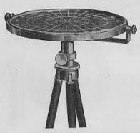
The WInd VElocity Radar Nephoscope (WIVERN): a candidate mission for the ESA Earth Explorer 11
Battaglia, A. Illingworth, F. Tridon, A. Rizik and ESA MAG team
Notes:
1

Slide 2
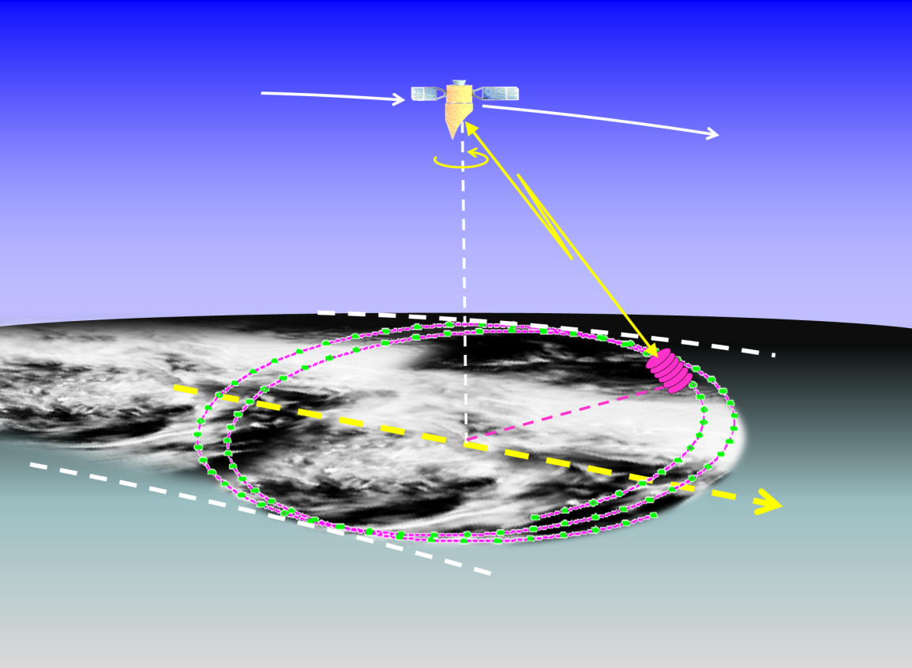
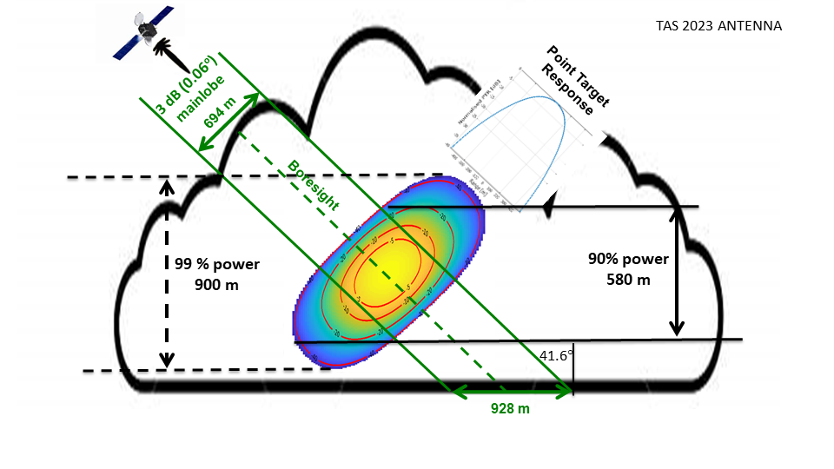
WIVERN INSTRUMENT
W-band (94 GHz, 3 mm, sensitivity down to -20 dBZ at 5 km integration)
Conically scanning at 41 degrees (800 km swath)
Doppler capability (polarization diversity) for measuring LoS horizontal winds
Big >3m antenna (θ_{3dB}≈0.07º) (vertical resolution of 600 m, horizontal < 1km)
Polar satellite, dawn-dusk sun-synchronous orbit (1.5 day average revisit time)
www.wivern.polito.it
Wolde et al., AMT 2018
Battaglia et al, AMT, 2018, 2022, 2023
Illingworth et al., BAMS, 2018.
Battaglia et al, IEEE TGRS, 2017
First mission to acquire line-of-sight wind profiles in clouds on a global scale.
Notes:
A WIVERN E2E Simulator has been developed that uses winds from the ECWMF analysis and CloudSat reflectivities to simulate WIVERN observables. Below an example of a CloudSat overpass over typhoon Mitag.
How many winds in cyclones?
In 2007 CloudSat observed 1250 overpasses of Tropical Cyclones (TCs) with, on average, 5600 wind precise to 2 m/s per overpass predicted by the simulator.
For each TC overpass, WIVERN, sampling an 800 km swath by scanning at 500 km/s, will observe 35 times more profiles than CloudSat samples at vertical incidence.
Over a typical year, with 1250 overpasses over TCs, WIVERN should measure 245 million winds in TCs with a precision of 2 m/s.

Slide 3
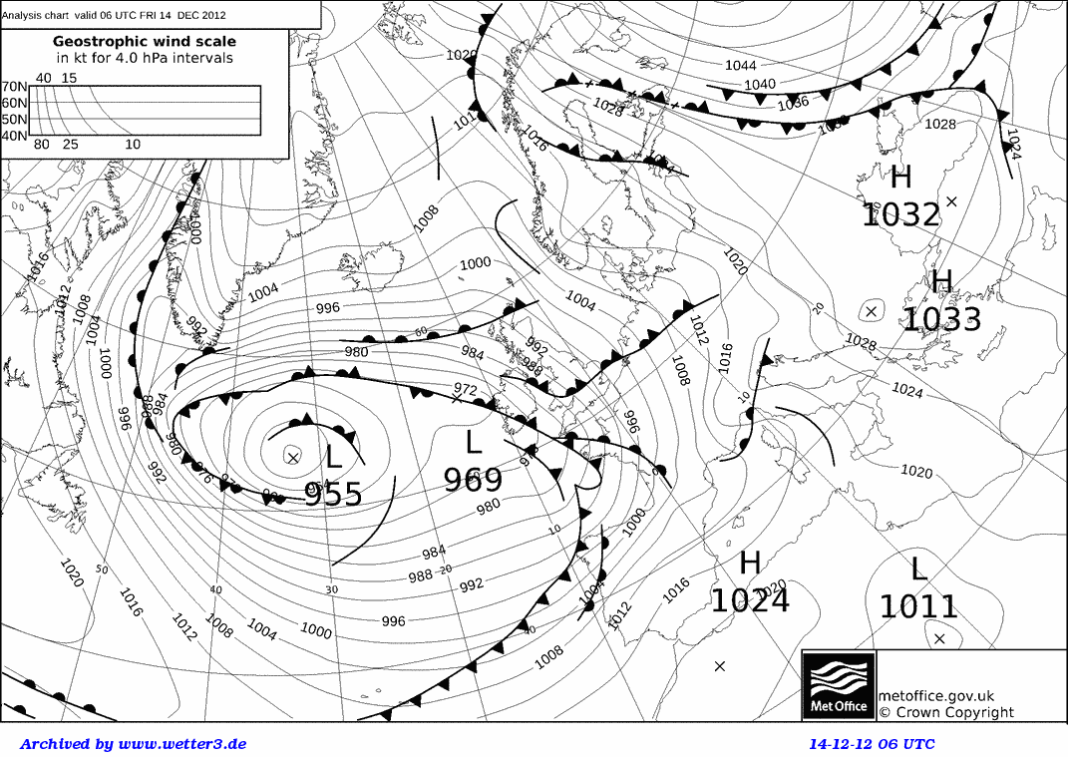
WIVERN: Science objective 1 (Doppler measurement)
To measure, for the first time, global vertically-resolved in-cloud winds to:
Help fill a critical gap in the global observing system, by providing near real-time wind observations in cloudy stratiform conditions, including tropical cyclones and mid-latitude wind-storms for the benefit of Numerical Weather Prediction (NWP).
- Contribute to our understanding of Earth's atmosphere and dynamics by the first-ever vertically resolved in-cloud wind climatology record.
https://dev.explorer.wivern.adamplatform.eu/

Slide 4
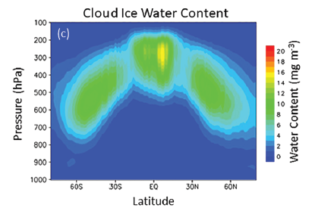
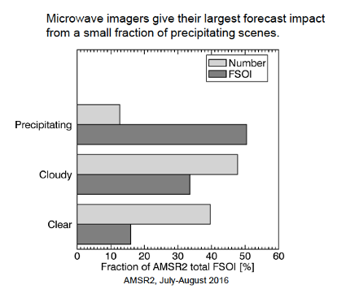
WIVERN: Science objective 2 (Z and TB measurement)
2) To provide reflectivity profiles and co-located brightness temperatures as well as microphysical properties of cloud and precipitation systems, at unprecedented spatial and temporal resolution, to contribute:
some of the Essential Climate Variables (Cloud Cover, Cloud Liquid Water Path, Cloud Ice Water Path, Cloud Top Height) for climatological studies of Precipitation and Clouds in the 2030s (continuation of CloudSat&EarthCARE global data sets) ➔ cloud feedbacks in climate system
- Near real-time observations for the benefit of NWP and climate models.

Slide 5
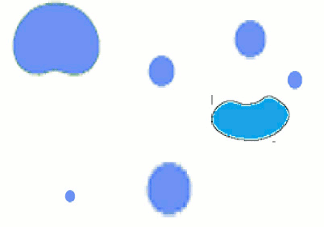
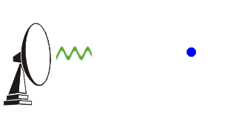
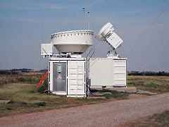
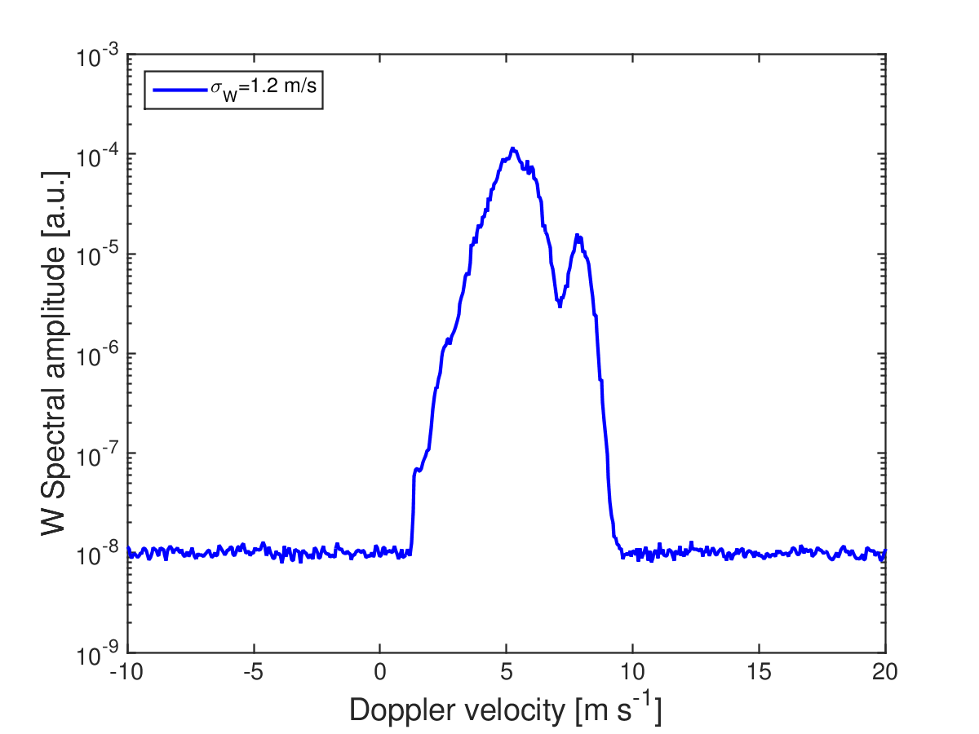
The challenge of Doppler from space
Key condition for pulse-pair radar Doppler: medium maintains coherency between two pulses ➔ targets do not reshuffle too much, i.e. their relative motion is ≤λ
Wolde et al., AMT 2018
Illingworth et al., BAMS, 2018.
Battaglia et al., IEEE TGRS, 2017
Battaglia et al., AMT, 2018, 2022, 2023
T=t0
λ=3.2 mm
Ground based
W-band Doppler spectrum
PRF≥3 kHz ➔ Doppler is possible with corresponding unambiguous range ≤50 km

Slide 6
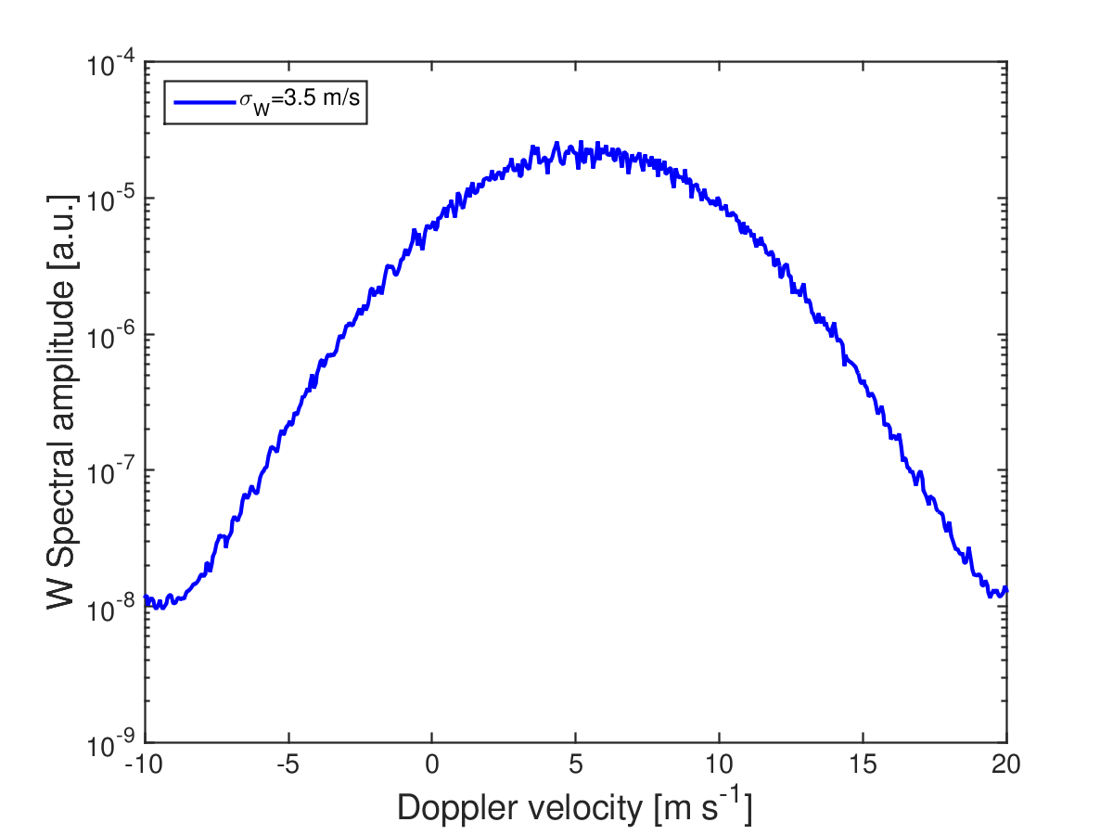
The challenge of Doppler from space
V_{Satellite}=7.6 km/s
Wolde et al., AMT 2018
Illingworth et al., BAMS, 2018.
Battaglia et al., IEEE TGRS, 2017
Battaglia et al., AMT, 2018, 2022, 2023
``Doppler fading’’
4.5 m/s (along the most forward direction)
Radar appears approaching the rain
target appears to move upward
Beamwidth
0.065º
Radar receding
➔ target move downward
$$σ_{D}≈3−4 m/s⇒ T_{dec}=100 μs$$
$PRF$≥$10 kHz$
Rain falling down at v_{D}=4 m/s
0.5 m/s
-4 m/s
$r_{max}≤\frac{c}{2 PRF}=15 km$ (h_{max}=11.2 km)
way too small to profile the troposphere!!!
-8.5 m/s
apparent
velocity

Slide 7
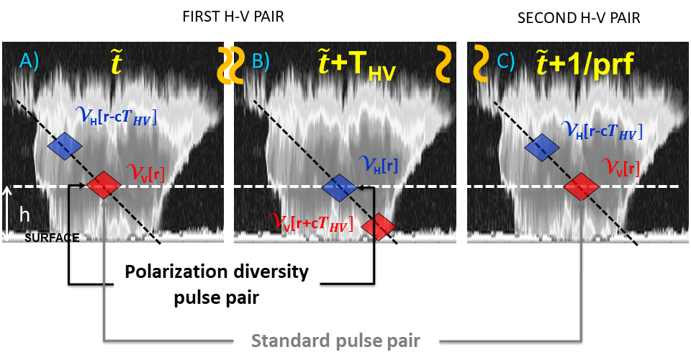
WIVERN: why polarization diversity?
Doppler velocity is derived from the phase shift of the returns from successive pulses with polarisation diversity.
Pulses need to be close enough to beat the fast decorrelation time of atmospheric targets while keeping unambiguous ranges long enough to sample the troposphere.
Wivern baseline:
T_{hv}=20 μs ➔ v_{Nyquist}=40 m/s
PRF=4 kHz ➔ r_{max}=37.5 km
$r_{max}=\frac{c}{2 PRF}$
decoupled!!
www.wivern.polito.it
$$v_{Nyquist}=\frac{λ}{4T_{HV}}$$
Key property of V and H pulses:
High degree of correlation between the orthogonal copolarized backscatter coefficients of atmospheric particles.
The isolation between H and V signals prevents ambiguity.

Slide 8
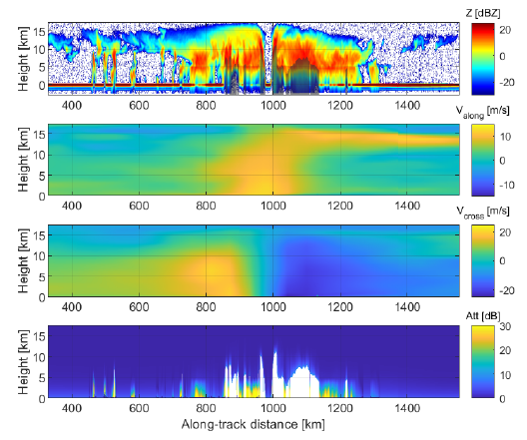
WIVERN end-to-end simulator
Reconstructed Wivern observations based on CloudSat measurements for typhoon Choi-wan (1/9/2009) accounting for the slant view
Reflectivity curtain from 2B-GEOPROF
ECMWF cross-track and along track winds
Attenuation estimate from 2C-RAIN-PROFILE
(+ iterative correction up to 6 dB where surface is not visible)
Notes:
A WIVERN E2E Simulator has been developed that uses winds from the ECWMF analysis and CloudSat reflectivities to simulate WIVERN observables. Below an example of a CloudSat overpass over typhoon Mitag.
How many winds in cyclones?
In 2007 CloudSat observed 1250 overpasses of Tropical Cyclones (TCs) with, on average, 5600 wind precise to 2 m/s per overpass predicted by the simulator.
For each TC overpass, WIVERN, sampling an 800 km swath by scanning at 500 km/s, will observe 35 times more profiles than CloudSat samples at vertical incidence.
Over a typical year, with 1250 overpasses over TCs, WIVERN should measure 245 million winds in TCs with a precision of 2 m/s.

Slide 9
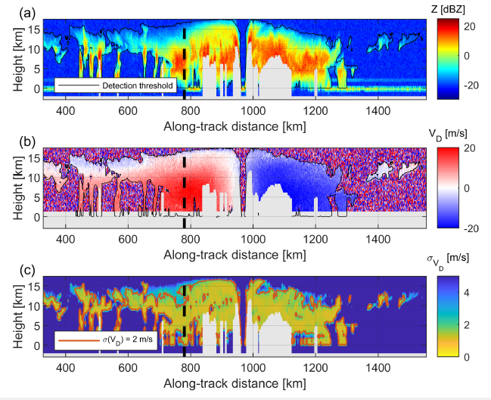
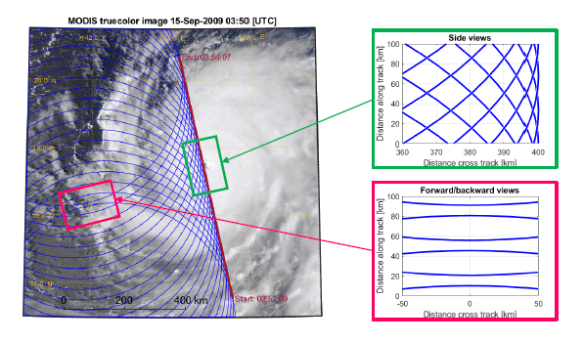
WIVERN end-to-end simulator of the wind product
Tridon et al., 2023, Earth and Space Science
WIVERN reflectivity curtain with no data where attenuation is unknown
Doppler velocity errors after correcting for non uniform beam filling and wind shear biases
Notes:
A WIVERN E2E Simulator has been developed that uses winds from the ECWMF analysis and CloudSat reflectivities to simulate WIVERN observables. Below an example of a CloudSat overpass over typhoon Mitag.
How many winds in cyclones?
In 2007 CloudSat observed 1250 overpasses of Tropical Cyclones (TCs) with, on average, 5600 wind precise to 2 m/s per overpass predicted by the simulator.
For each TC overpass, WIVERN, sampling an 800 km swath by scanning at 500 km/s, will observe 35 times more profiles than CloudSat samples at vertical incidence.
Over a typical year, with 1250 overpasses over TCs, WIVERN should measure 245 million winds in TCs with a precision of 2 m/s.

Slide 10
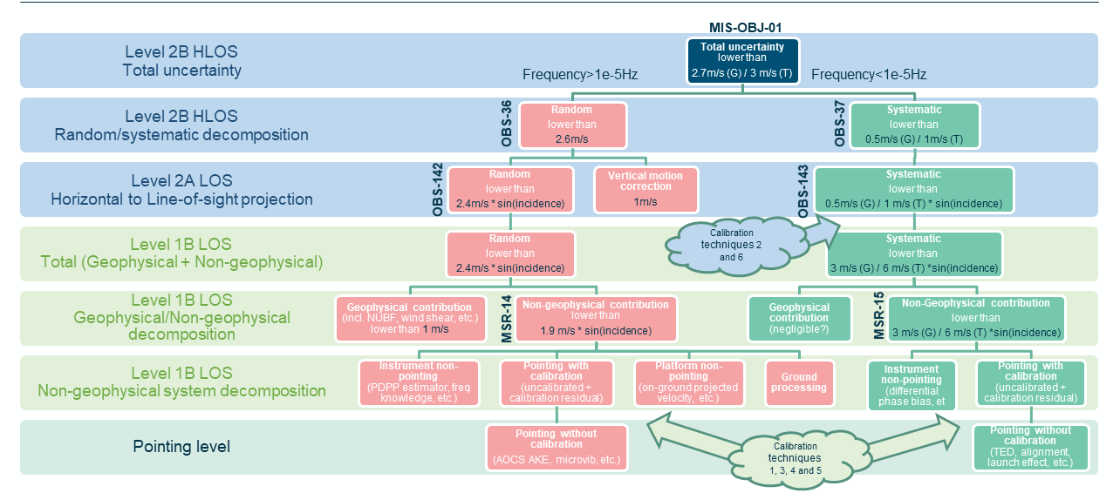
H-LoS WIND: error budget
Directly used in data assimilation for stratiform areas where vertical wind is negligble
Error sources: mispointing, non uniform beam filling, wind shear, hydrometeor terminal velocity correction
Notes:
A WIVERN E2E Simulator has been developed that uses winds from the ECWMF analysis and CloudSat reflectivities to simulate WIVERN observables. Below an example of a CloudSat overpass over typhoon Mitag.
How many winds in cyclones?
In 2007 CloudSat observed 1250 overpasses of Tropical Cyclones (TCs) with, on average, 5600 wind precise to 2 m/s per overpass predicted by the simulator.
For each TC overpass, WIVERN, sampling an 800 km swath by scanning at 500 km/s, will observe 35 times more profiles than CloudSat samples at vertical incidence.
Over a typical year, with 1250 overpasses over TCs, WIVERN should measure 245 million winds in TCs with a precision of 2 m/s.

Slide 11
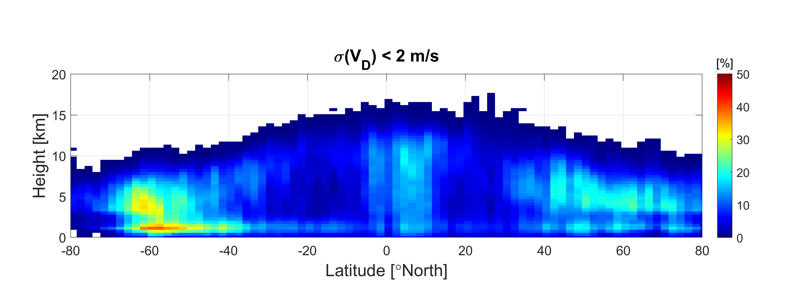
WIVERN: where are we going to see winds?
Based on 1 year of WIVERN global simulations reconstructed fromCloudSat observations
Error on LoS winds
Note increased noisiness in the Doppler due to contamination by cross-talk
(stronger over land bright surfaces)
Notes:
A WIVERN E2E Simulator has been developed that uses winds from the ECWMF analysis and CloudSat reflectivities to simulate WIVERN observables. Below an example of a CloudSat overpass over typhoon Mitag.
How many winds in cyclones?
In 2007 CloudSat observed 1250 overpasses of Tropical Cyclones (TCs) with, on average, 5600 wind precise to 2 m/s per overpass predicted by the simulator.
For each TC overpass, WIVERN, sampling an 800 km swath by scanning at 500 km/s, will observe 35 times more profiles than CloudSat samples at vertical incidence.
Over a typical year, with 1250 overpasses over TCs, WIVERN should measure 245 million winds in TCs with a precision of 2 m/s.

Slide 12
WIVERN: how many winds?
WIVERN will provide about 2 millions accurate winds daily at 20 km horizontal and 650 m vertical resolutions.
Touchstones
Atmospheric Motion Vectors: ~7M/day, 300k/day DA, (error ~4m/s)
Aircrafts: 1 M/day, 360K/day DA, (error 2.0m/s)
ADM Aeolus: 130,000 Rayleigh (89 km) & 50,000 Mie (error 3-4 m/s)-cloudy (12 km) (error 5-7 m/s)
Notes:
A WIVERN E2E Simulator has been developed that uses winds from the ECWMF analysis and CloudSat reflectivities to simulate WIVERN observables. Below an example of a CloudSat overpass over typhoon Mitag.
How many winds in cyclones?
In 2007 CloudSat observed 1250 overpasses of Tropical Cyclones (TCs) with, on average, 5600 wind precise to 2 m/s per overpass predicted by the simulator.
For each TC overpass, WIVERN, sampling an 800 km swath by scanning at 500 km/s, will observe 35 times more profiles than CloudSat samples at vertical incidence.
Over a typical year, with 1250 overpasses over TCs, WIVERN should measure 245 million winds in TCs with a precision of 2 m/s.

Slide 13
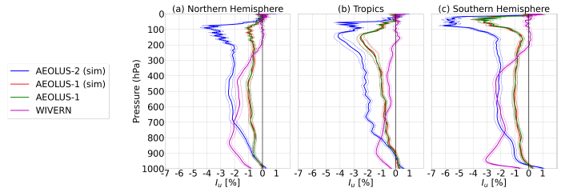
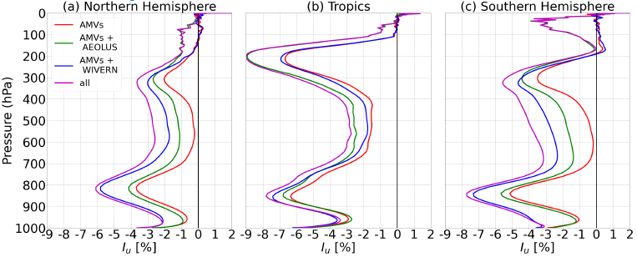
WIVERN impact on data assimilation
WIVERN observations of in–cloud winds when combined with the winds from the clear air and thin clouds from the Doppler lidar on the recently approved Aeolus follow-on mission will produce a significant improvement in NWP forecast accuracy.
Impact measured by a reduction of the operational Ensemble Data Assimilation spread for the ARPEGE global NWP model at analysis time and other forecast ranges.
WIVERN has a significant positive impact on the reduction in EDA spread, especially in the lower troposphere (below 300 hPa).
Courtesy: Mary Borderies, Meteo France

Slide 14
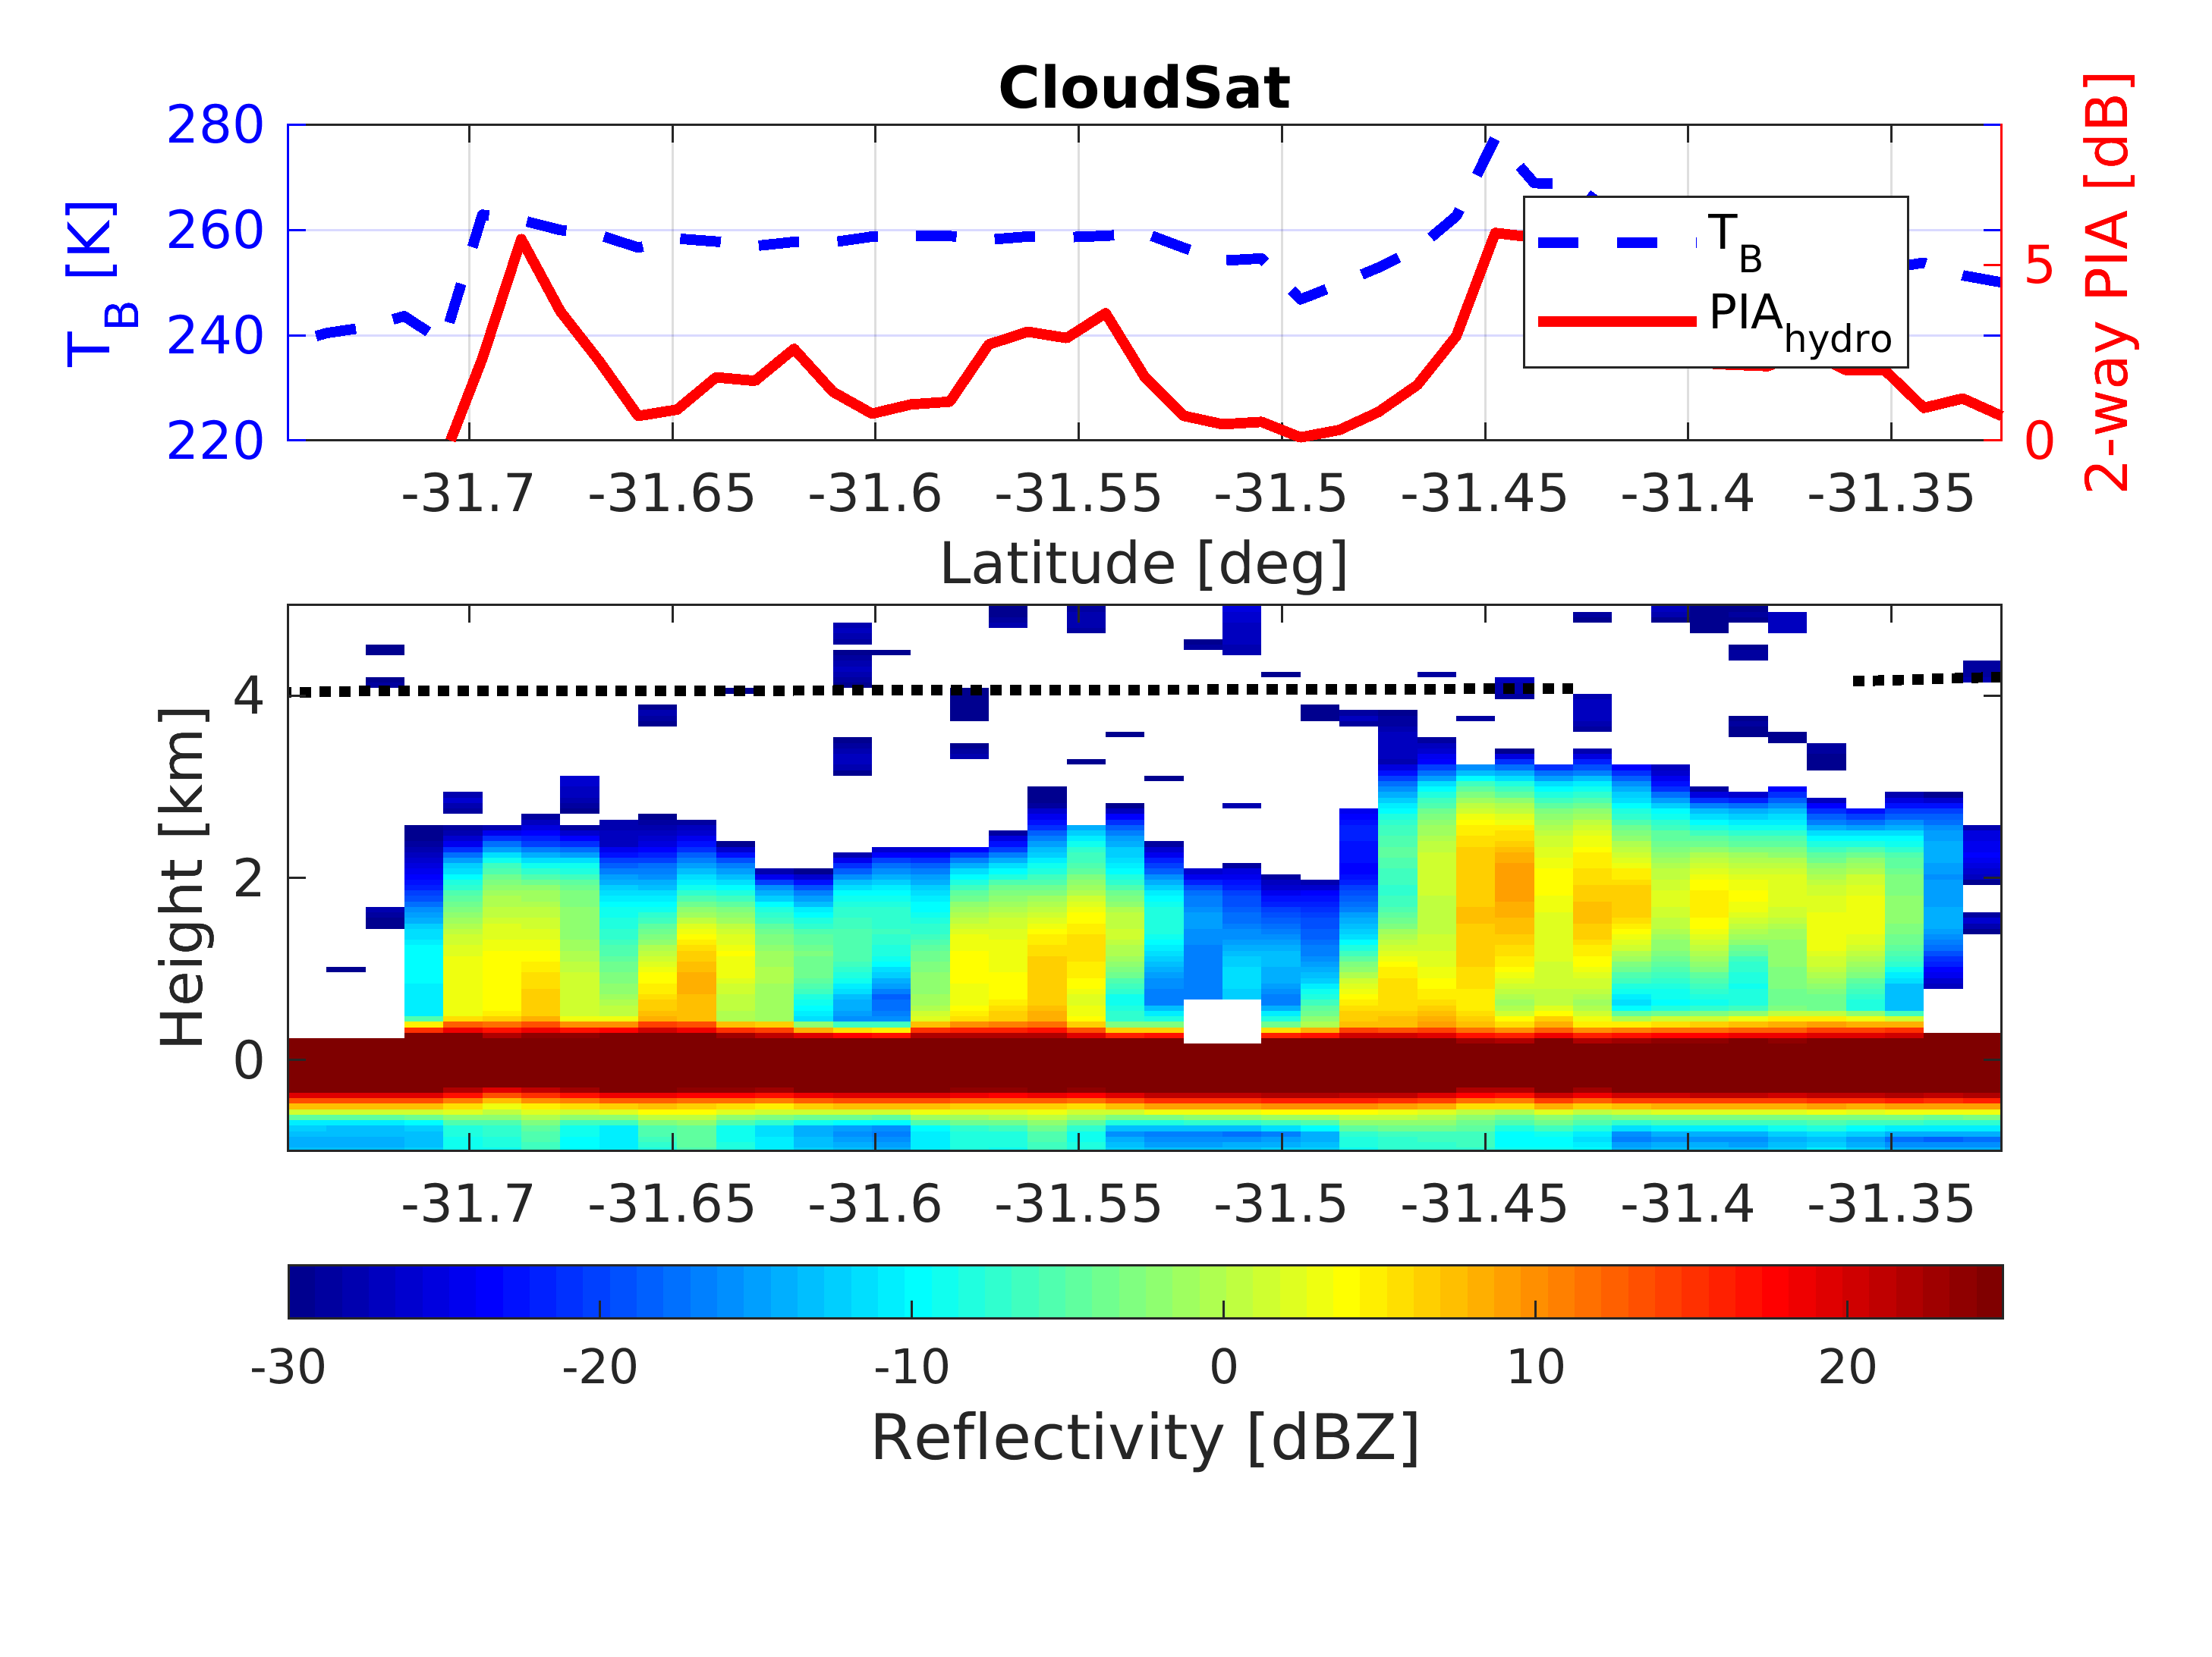
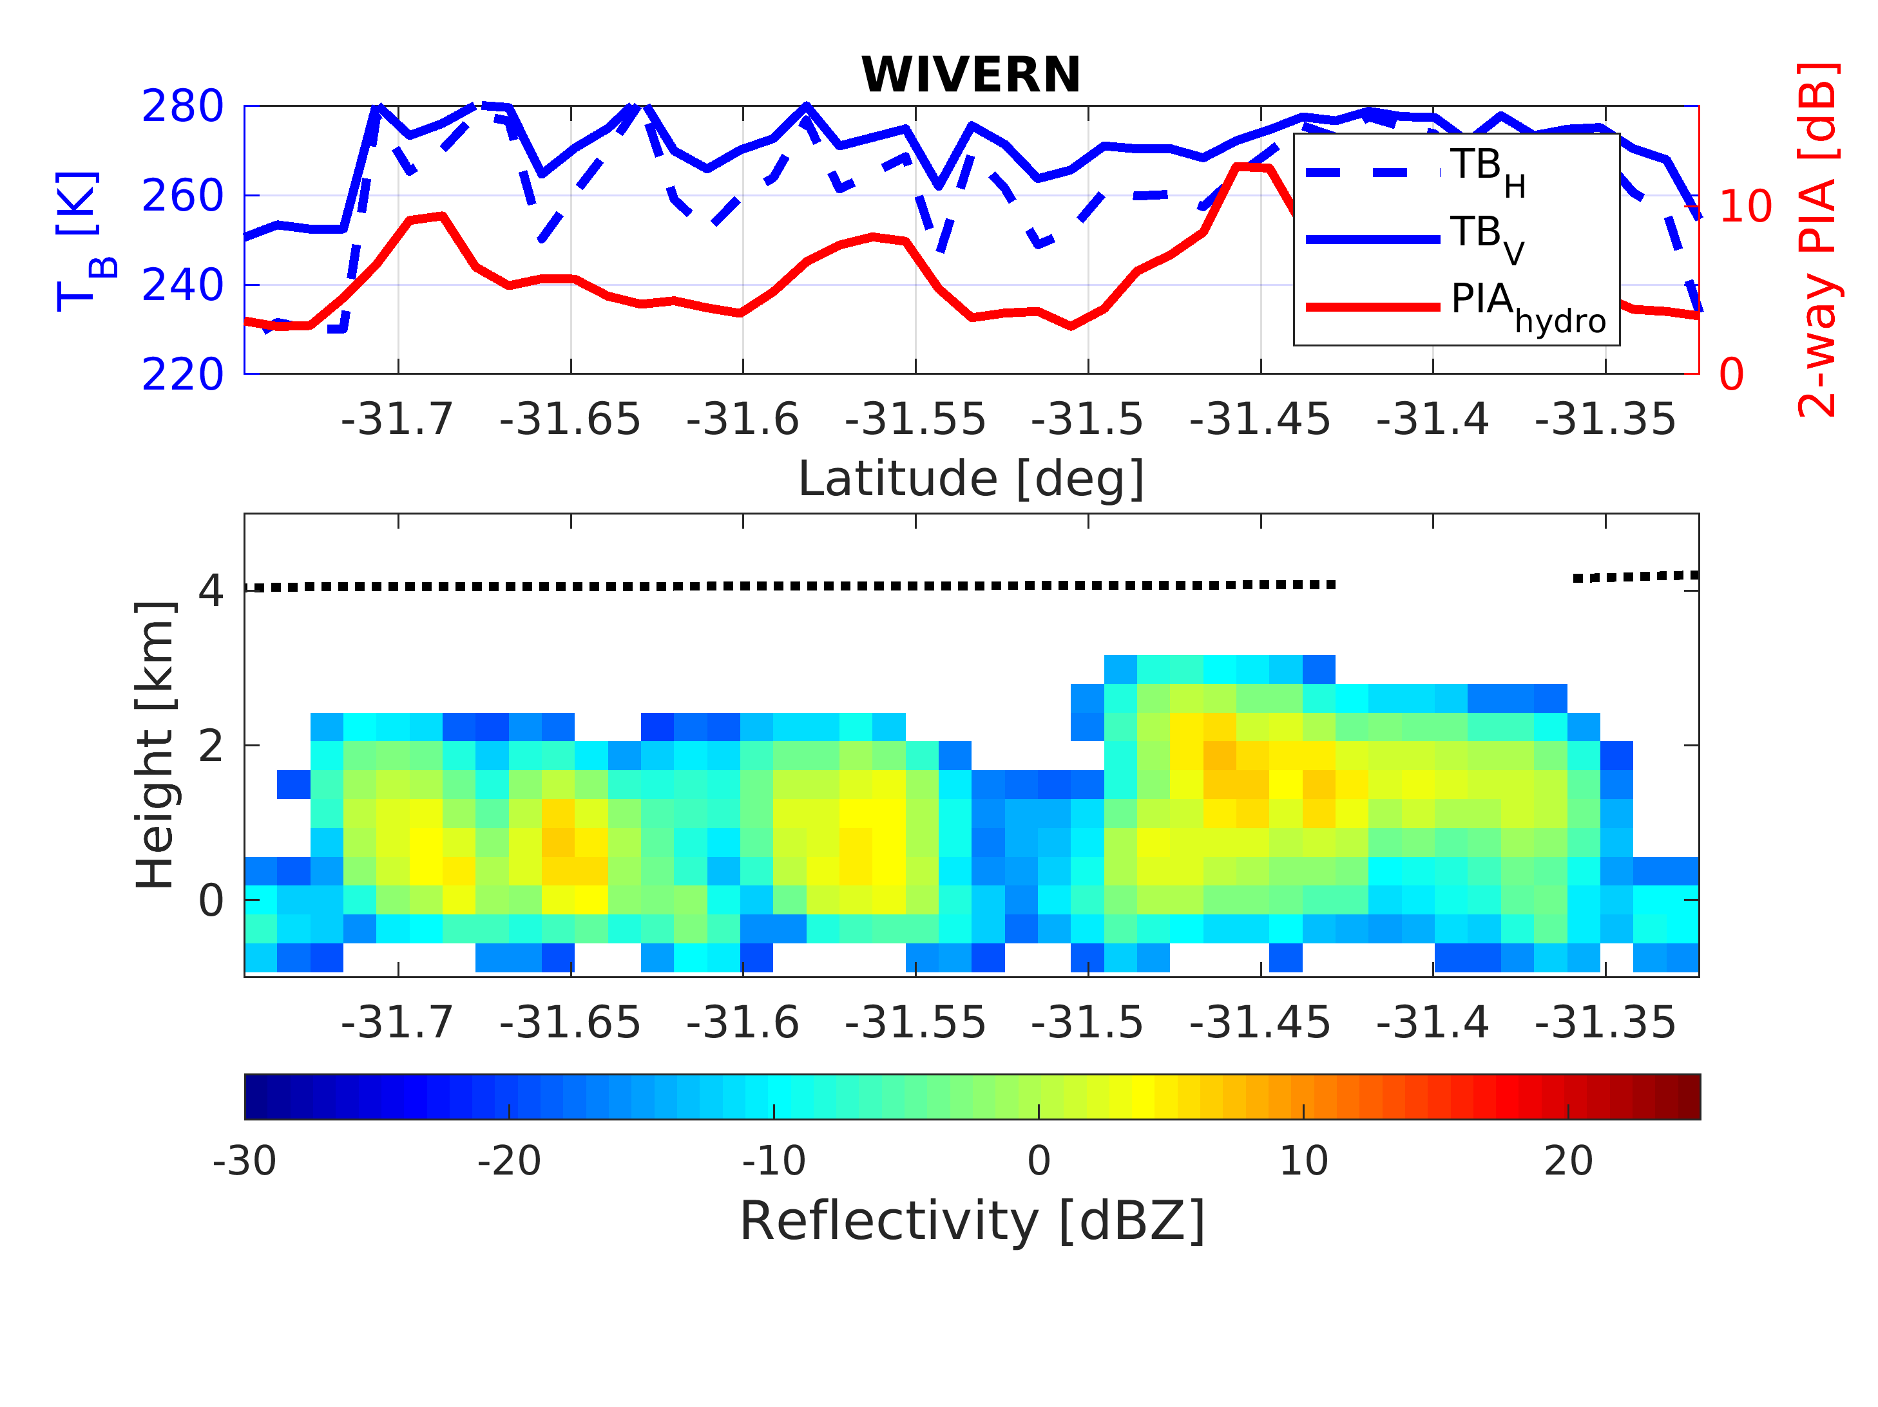
WIVERN cloud and precipitation products
Warm rain oceanic scene
Reduced clutter
TB_{V} and TB_{H} with enhanced dynamic
Notes:
A WIVERN E2E Simulator has been developed that uses winds from the ECWMF analysis and CloudSat reflectivities to simulate WIVERN observables. Below an example of a CloudSat overpass over typhoon Mitag.
How many winds in cyclones?
In 2007 CloudSat observed 1250 overpasses of Tropical Cyclones (TCs) with, on average, 5600 wind precise to 2 m/s per overpass predicted by the simulator.
For each TC overpass, WIVERN, sampling an 800 km swath by scanning at 500 km/s, will observe 35 times more profiles than CloudSat samples at vertical incidence.
Over a typical year, with 1250 overpasses over TCs, WIVERN should measure 245 million winds in TCs with a precision of 2 m/s.

Slide 15
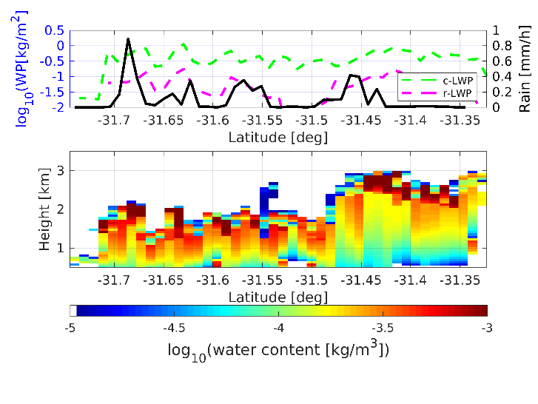
WIVERN cloud and precipitation products
PRODUCTS: ice water content, liquid water path, snowfall and rainfall
Products based on the heritage of CloudSat and EarthCARE cloud profiling radars, but with 30-40 times better sampling
Snowfall and rainfall over ocean will benefit from darkening of σ₀
Notes:
A WIVERN E2E Simulator has been developed that uses winds from the ECWMF analysis and CloudSat reflectivities to simulate WIVERN observables. Below an example of a CloudSat overpass over typhoon Mitag.
How many winds in cyclones?
In 2007 CloudSat observed 1250 overpasses of Tropical Cyclones (TCs) with, on average, 5600 wind precise to 2 m/s per overpass predicted by the simulator.
For each TC overpass, WIVERN, sampling an 800 km swath by scanning at 500 km/s, will observe 35 times more profiles than CloudSat samples at vertical incidence.
Over a typical year, with 1250 overpasses over TCs, WIVERN should measure 245 million winds in TCs with a precision of 2 m/s.

Slide 16
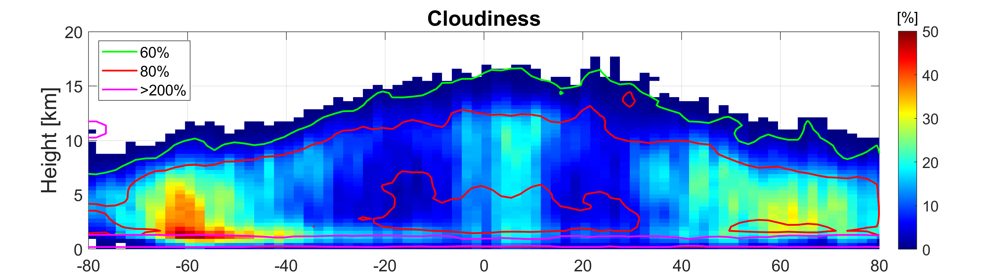
WIVERN: how many clouds?
Note that in the first km close to the surface the WIVERN signal to clutter ratio will be much better than for CloudSat and EarthCARE➔ benefit for precipitation products
Notes:
A WIVERN E2E Simulator has been developed that uses winds from the ECWMF analysis and CloudSat reflectivities to simulate WIVERN observables. Below an example of a CloudSat overpass over typhoon Mitag.
How many winds in cyclones?
In 2007 CloudSat observed 1250 overpasses of Tropical Cyclones (TCs) with, on average, 5600 wind precise to 2 m/s per overpass predicted by the simulator.
For each TC overpass, WIVERN, sampling an 800 km swath by scanning at 500 km/s, will observe 35 times more profiles than CloudSat samples at vertical incidence.
Over a typical year, with 1250 overpasses over TCs, WIVERN should measure 245 million winds in TCs with a precision of 2 m/s.

Slide 17
Conclusions
WIVERN is an ESA EE11 candidate mission, currently in Phase 0 (downselection to 2 at the end of 2023, launch in 2030).
It hinges upon a single cutting-edge radar instrument: first-ever conically scanning W-band radar with Doppler capabilities.
Flagship product: in-cloud vertical profiles of winds over a large swath➔ plenty of winds are expected (>2 million line of sight wind measurements at 20 km resolution per day) with expected great impact in data assimilation (complement Aeolus in cloudy mid and low troposphere region)
Cloud and precipitation product: as done in CloudSat/EarthCARE but with 30-40 times better sampling
WIVERN is an ideal observing system for understanding clouds and their dynamics!
Notes:
A WIVERN E2E Simulator has been developed that uses winds from the ECWMF analysis and CloudSat reflectivities to simulate WIVERN observables. Below an example of a CloudSat overpass over typhoon Mitag.
How many winds in cyclones?
In 2007 CloudSat observed 1250 overpasses of Tropical Cyclones (TCs) with, on average, 5600 wind precise to 2 m/s per overpass predicted by the simulator.
For each TC overpass, WIVERN, sampling an 800 km swath by scanning at 500 km/s, will observe 35 times more profiles than CloudSat samples at vertical incidence.
Over a typical year, with 1250 overpasses over TCs, WIVERN should measure 245 million winds in TCs with a precision of 2 m/s.

Slide 18
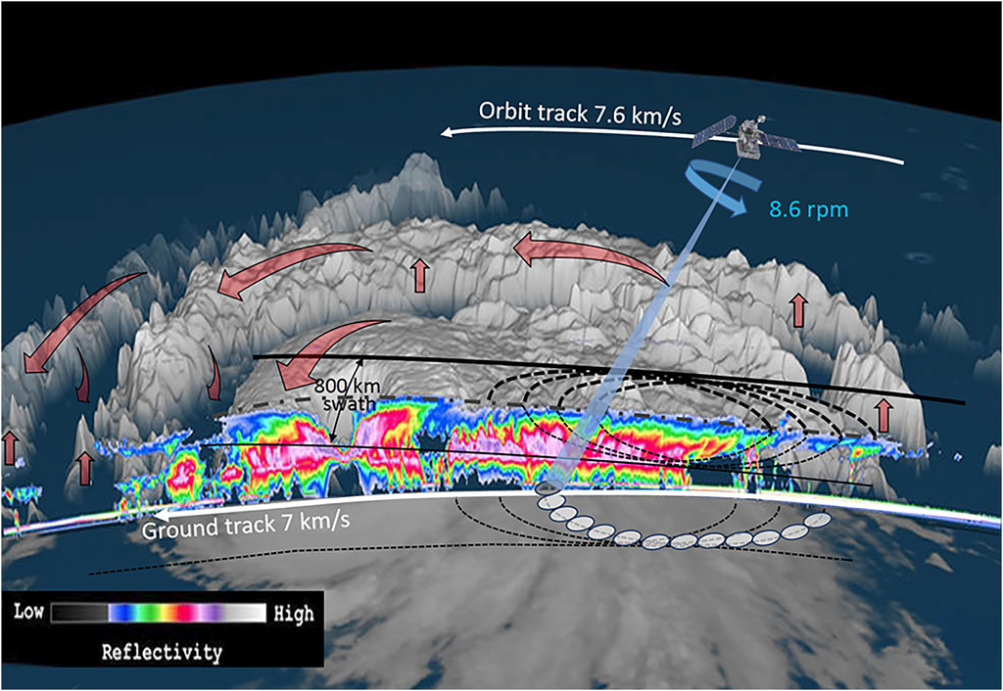
Thanks for the attention
12 rpm
www.wivern.polito.it
Contact point: alessandro.battaglia@polito.it

Slide 19
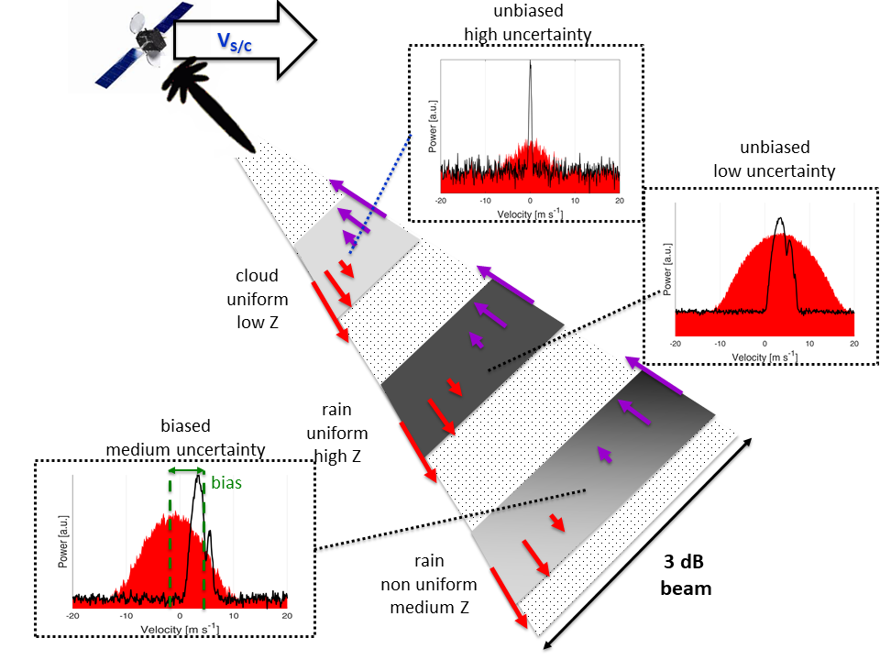
Non uniform beam filling
Notes:
A WIVERN E2E Simulator has been developed that uses winds from the ECWMF analysis and CloudSat reflectivities to simulate WIVERN observables. Below an example of a CloudSat overpass over typhoon Mitag.
How many winds in cyclones?
In 2007 CloudSat observed 1250 overpasses of Tropical Cyclones (TCs) with, on average, 5600 wind precise to 2 m/s per overpass predicted by the simulator.
For each TC overpass, WIVERN, sampling an 800 km swath by scanning at 500 km/s, will observe 35 times more profiles than CloudSat samples at vertical incidence.
Over a typical year, with 1250 overpasses over TCs, WIVERN should measure 245 million winds in TCs with a precision of 2 m/s.

Slide 20
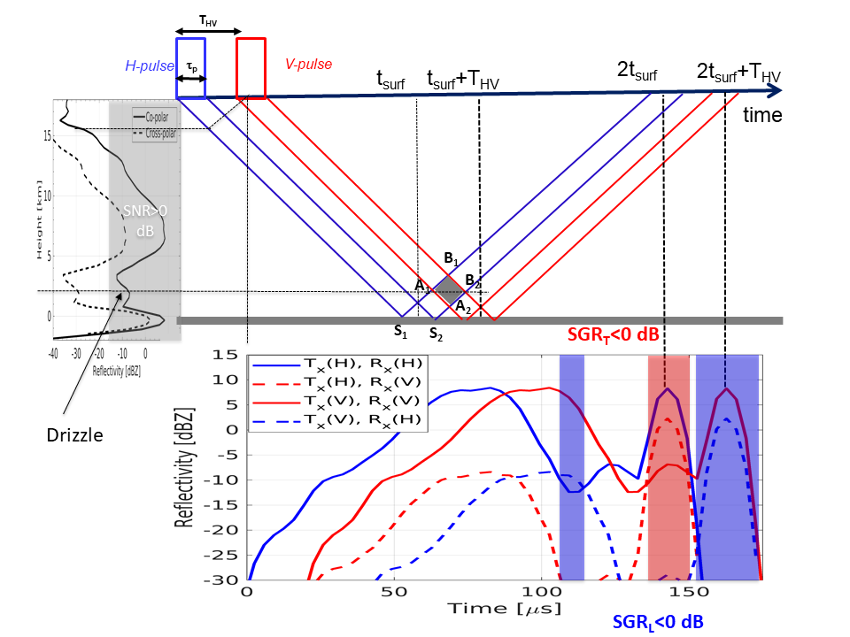
Cross talk effect
Notes:
A WIVERN E2E Simulator has been developed that uses winds from the ECWMF analysis and CloudSat reflectivities to simulate WIVERN observables. Below an example of a CloudSat overpass over typhoon Mitag.
How many winds in cyclones?
In 2007 CloudSat observed 1250 overpasses of Tropical Cyclones (TCs) with, on average, 5600 wind precise to 2 m/s per overpass predicted by the simulator.
For each TC overpass, WIVERN, sampling an 800 km swath by scanning at 500 km/s, will observe 35 times more profiles than CloudSat samples at vertical incidence.
Over a typical year, with 1250 overpasses over TCs, WIVERN should measure 245 million winds in TCs with a precision of 2 m/s.

Slide 21
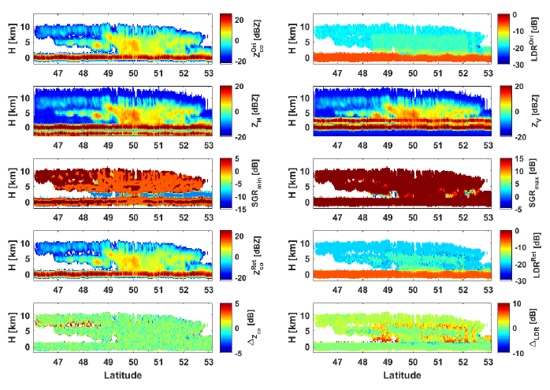
Cross talk effect
Rizik et al, IEEE TGRS,
submitted
Notes:
A WIVERN E2E Simulator has been developed that uses winds from the ECWMF analysis and CloudSat reflectivities to simulate WIVERN observables. Below an example of a CloudSat overpass over typhoon Mitag.
How many winds in cyclones?
In 2007 CloudSat observed 1250 overpasses of Tropical Cyclones (TCs) with, on average, 5600 wind precise to 2 m/s per overpass predicted by the simulator.
For each TC overpass, WIVERN, sampling an 800 km swath by scanning at 500 km/s, will observe 35 times more profiles than CloudSat samples at vertical incidence.
Over a typical year, with 1250 overpasses over TCs, WIVERN should measure 245 million winds in TCs with a precision of 2 m/s.

